Slide 1

Web Essentials: From Code to Career
A 3 Day Hands On Workshop – Day 2
Welcome !!
Get Ready to Build the Web !!

Slide 2
Backend Development with JSP
Connecting Frontend to Database
JSP (Java Server Pages) Introduction
Database Connectivity with MySQL
MVC Architecture
Session Management
Complete User Management System

Slide 3
Today's Roadmap
JSP Fundamentals
What is JSP & How it Works
JSP Elements & Lifecycle
Implicit Objects
Database Integration
JDBC with MySQL
JSP + JavaBeans
Advanced Concepts
MVC Architecture
Session Management
Hands-On Project
User Management System (Login, Register, CRUD, Logout)

Slide 4
JSP - Java Server Pages
What is JSP?
Server-side technology for dynamic web pages
Embeds Java code in HTML using special tags
Easier than Servlets for UI-based applications
Why JSP?
Separation of presentation (HTML) and business logic (Java)
Supports Java directly inside HTML
Ideal for Login forms, Dashboards, CRUD Applications

Slide 5
How JSP Works
Processing Flow:
Browser sends HTTP request to Tomcat Server
JSP page converted into Java servlet
Servlet compiled into bytecode
Executed by JVM
HTML output sent back to browser
Flow Diagram:
Browser → Tomcat → JSP Engine → Servlet → Compiled Java → HTML

Slide 6
Tools & Software Setup
Tool | Purpose | Version
JDK | Compile Java/JSP | JDK 17+
Apache Tomcat | Web Server | Tomcat 9/10
Eclipse IDE | Java Web Projects | Enterprise Edition
MySQL | Database | MySQL 8.0
MySQL Workbench | GUI Database Tool | Optional
JDBC Connector | Java-MySQL Connection | mysql-connector-j.jar

Slide 7
JSP Elements
Type | Description | Example
Directives | Instructions to container | <%@ page language="java" %>
Scripting | Embed Java code | <% int x = 10; %>
Actions/Tags | Control behavior | <jsp:useBean>
Implicit Objects | Predefined objects | request.getParameter()

Slide 8
Scripting Elements
Element | Syntax | Description
Declaration | <%! int count = 0; %> | Declare variables/methods
Scriptlet | <% out.println("Hello"); %> | Write Java code
Expression | <%= count %> | Print value directly
Example :
<%! int num = 10; %>
<% num += 5; %>
<h3>Result: <%= num %></h3>

Slide 9
Directives
Page Directive:
<%@ page language="java" contentType="text/html; charset=UTF-8" %>
Include Directive:
<%@ include file="header.jsp" %>
Taglib Directive:
<%@ taglib uri="http://java.sun.com/jsp/jstl/core" prefix="c" %>

Slide 10
JSP Life Cycle
5 Phases
              Translation - JSP → Servlet
        Compilation - Servlet → Class file
        Initialization - jspInit()
        Request Processing - _jspService()
        Destruction - jspDestroy()
Compilation Flow:
index.jsp → index_jsp.java → index_jsp.class → executed

Slide 11
Implicit Objects
Object | Description | Example
request | Gets data from client | request.getParameter("username")
response | Sends data to client | response.setContentType()
session | Stores user session | session.getAttribute("user")
out | Writes output to browser | out.println("Welcome")

Slide 12
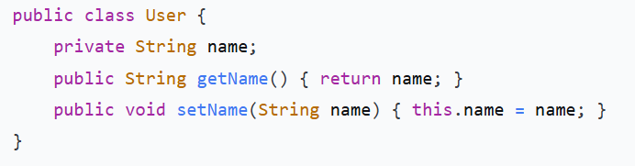
JSP + JavaBeans
Separation of Business Logic & Presentation
JavaBean (User.java):
JSP Usage:
<jsp:useBean id="user" class="com.demo.User" />
<jsp:setProperty name="user" property="name" value="Chetan" />
Hello <jsp:getProperty name="user" property="name" />!

Slide 13
JSP + Database Connectivity (JDBC + MySQL)
1. Install MySQL & create database
3. Use JDBC in JSP
2. Add mysql-connector-j.jar to /lib/
<%@ page import="java.sql.*" %>
<%
    Connection con = DriverManager.getConnection("jdbc:mysql://localhost:3306/jsp_demo", "root", "password");
    Statement st = con.createStatement();
    ResultSet rs = st.executeQuery("SELECT * FROM users");
    while(rs.next()) {
    out.println(rs.getString("name"));
    }
    con.close();
%>

Slide 14
MVC Architecture (Model-View-Controller)
Three Components:
      Model - Handles data & business logic
      View - Manages UI & presentation
      Controller - Controls flow between Model & View
Why MVC?
Separation of logic & presentation
Easy maintenance of large projects
Reusable & scalable structure
Individual layer testing

Slide 15
MVC Workflow
Step-by-Step Flow:
User interacts with web page (submits form)
Request goes to Controller (Servlet)
Controller communicates with Model
Model processes data (database operations)
Controller forwards data to View (JSP)
View displays result to user
Flow Diagram:
Browser → Controller (Servlet) ↔ Model (Java + Database) → View (JSP)

Slide 16
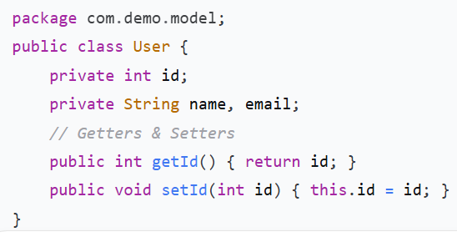
Model Component
Represents data & business logic
Interacts with database (JDBC, Hibernate)
Implemented as JavaBeans or Plain Java Classes
Example: User.java

Slide 17
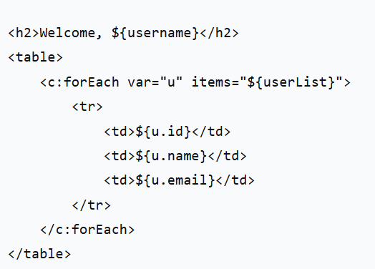
View Component
Presentation Layer (UI):
Implemented using JSP, HTML, CSS
No business logic
Displays data from Controller
Example dashboard.jsp

Slide 18
Controller Component
Link between View & Model:
Handles client requests
Calls Model for data processing
Selects appropriate View
Implemented using Servlets

Slide 19
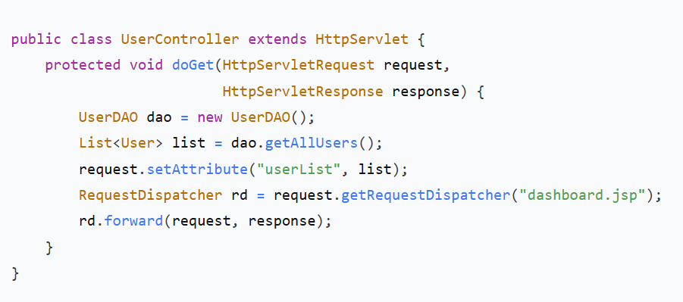
Controller Component
Example UserController.java

Slide 20
Session Management in JSP
What is Session?
Store user information across multiple requests
HTTP is stateless - sessions maintain state
Remember login state, shopping cart, preferences
How Sessions Work:
User logs in → Server creates session
Unique Session ID stored in browser cookie
Browser sends Session ID with each request
Server identifies user using Session ID

Slide 21
Session Management Techniques
Technique | Description | Use Case
Cookies | Data stored in browser | Small, non-sensitive info
URL Rewriting | Session ID in URL | When cookies disabled
Hidden Form Fields | Session info in forms | Simple data persistence
HttpSession Object | Server-side tracking | Most secure & recommended

Slide 22
Common Session Methods
Method | Description
session.setAttribute(name, value) | Store data in session
session.getAttribute(name) | Retrieve data from session
session.removeAttribute(name) | Remove specific attribute
session.invalidate() | Destroy entire session
session.getId() | Returns session ID
session.isNew() | Checks if new session

Slide 23
Session Example - Login System
login.jsp:
jsp
<form action="welcome.jsp" method="post">
Username: <input type="text" name="user">
<input type="submit" value="Login">
</form>

Slide 24
Session Example - Login System
welcome.jsp:
jsp
<%
String user = request.getParameter("user");
session.setAttribute("username", user);
%>
<h2>Welcome, <%= session.getAttribute("username") %></h2>

Slide 25
Session Example - Login System
profile.jsp:
jsp
<%
String user = (String) session.getAttribute("username");
if (user == null) {
response.sendRedirect("login.jsp");
}
%>
<h2>Hello again, <%= user %>!</h2>

Slide 26
Thanks!
Do you have any questions?
Thank you for your attention!
Let's start coding!

